Slide 1

Machine Learning Algorithms
Instructor
Md. Abu Naser Mojumder

Slide 2
Well known Machine Learning Algorithms
Supervised Learning
Unsupervised Learning
Reinforcement Learning
Regression
Simple Linear Regression
Multiple Linear Regression
Polynomial Regression
Clustering
K-Means Clustering
Hierarchical Clustering
Upper Confidence Bound(UCB)
Thomson Sampling
Classification
Logistic Regression
k-Nearest Neighbors(k-NN)
Support Vector Machine(SVM)
Naïve Bayes
Decision Tree Classification
Random Forest Classification
Dimensionality Reduction
Principal Component Analysis(PCA)
Linear Discriminant Analysis (LDA)
Deep Learning Algorithm
Artificial Neural Network(ANN)
Convolutional Neural Network(CNN)

Slide 3
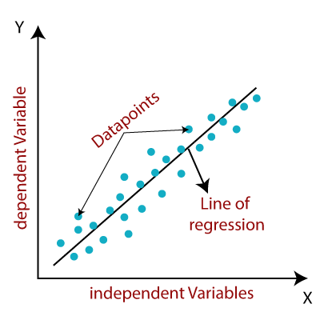
Regression
Regression models describe the relationship between variables by fitting a line to the observed data. Linear regression models use a straight line, while logistic and nonlinear regression models use a curved line. Regression allows you to estimate how a dependent variable changes as the independent variable(s) change.

Slide 4
Simple Linear Regression
Linear regression is a popular regression learning algorithm that learns a model which is a linear combination of features of the input example.
Simple linear regression is used to estimate the relationship between two quantitative variables. You can use simple linear regression when you want to know:
How strong the relationship is between two variables (e.g. the relationship between rainfall and soil erosion).
The value of the dependent variable at a certain value of the independent variable (e.g. the amount of soil erosion at a certain level of rainfall).
Two Main Objectives of Simple Regression:
Establish if there is a relationship between two variables.
Forecast new observations.

Slide 5

Simple Linear Regression
The equation of Simple Linear Regression:
bias term
co-efficient term
$$y=b_{0}+b_{1}∗x_{1}$$
independent variable
dependent variable
$b_{0}$ is a constant to fit the line properly. It is called y-intercept or bias.
$b_{1}$ is the slope of the relationship graph.

Slide 6
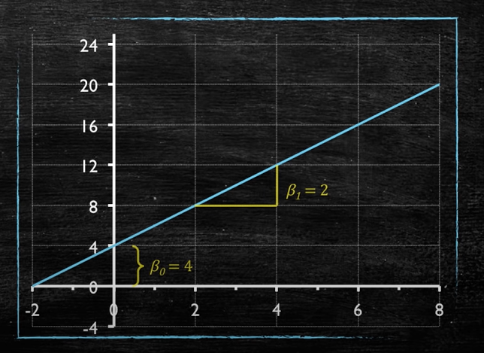


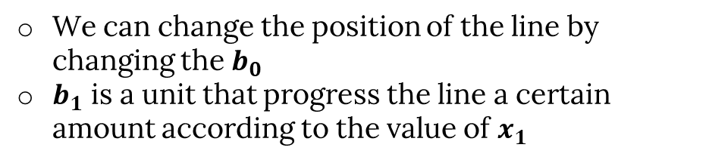
Simple Linear Regression
Example of Linear Equation:
$$y=b_{0}+b_{1}∗x_{1}$$
Equation in the figure:
$$y=4+2∗x_{1}$$
We can change the position of the line by changing the $b_{0}$
$b_{1}$ is a unit that progress the line a certain amount according to the value of $x_{1}$

Slide 7
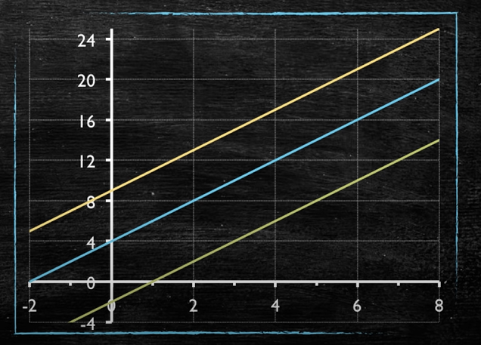



Simple Linear Regression
The changing effect of y-intercept:
$$y=9+2x$$
$$y=4+2x$$
$$y=−2+2x$$

Slide 8
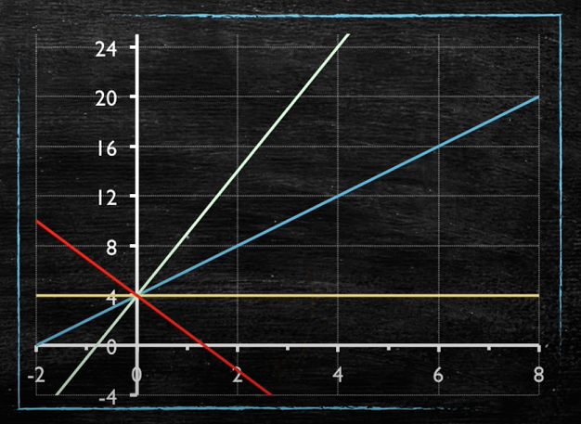




Simple Linear Regression
The changing effect of slope($b_{1}$):
$$y=4+2x$$
$$y=4+5x$$
$$y=4+0x$$
$$y=4−3x$$

Slide 9
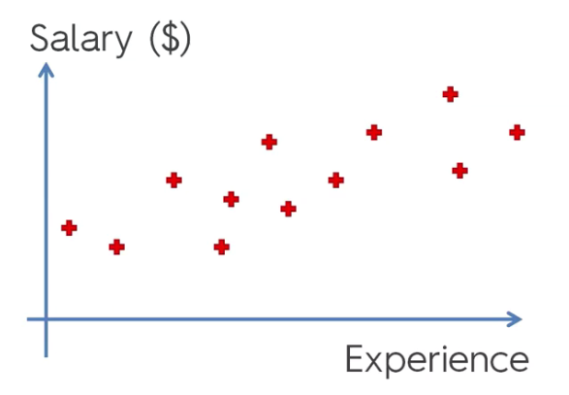

Simple Linear Regression
Example: Salary vs Experience
Salary is all vertical axis and we want to understand how people's salary depends on their experience.
In a certain company this is how salaries are distributed among people who have different levels of experience.
That’s a formula for aggression.
In our case it'll change to :
That essentially means is just putting a line through your chart that best fits this data.
$$y=b_{0}+b_{1}∗x_{1}$$
$$salary=b_{0}+b_{1}∗experiences$$

Slide 10
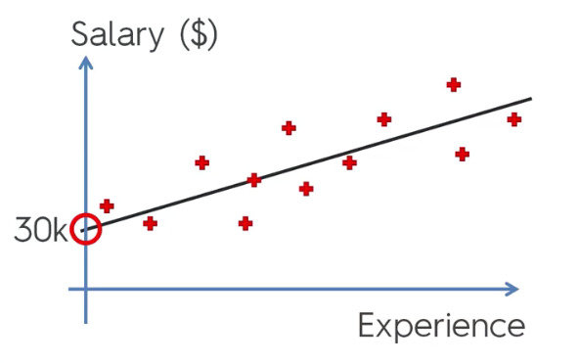
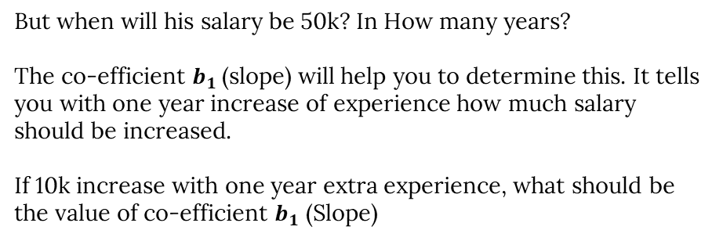
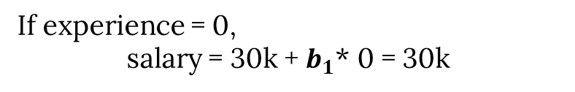
Simple Linear Regression
$$salary=b_{0}+b_{1}∗experiences$$
Meaning of the fitted line:
Let, $b_{0}$ = 30k
If experience = 0,
salary = 30k + $b_{1}$* 0 = 30k
That means, a person who is a fresher will get a salary 30k.
But when will his salary be 50k? In How many years?
The co-efficient $b_{1}$(slope) will help you to determine this. It tells you with one year increase of experience how much salary should be increased.
If 10k increase with one year extra experience, what should be the value of co-efficient $b_{1}$ (Slope)
Any Guess?

Slide 11
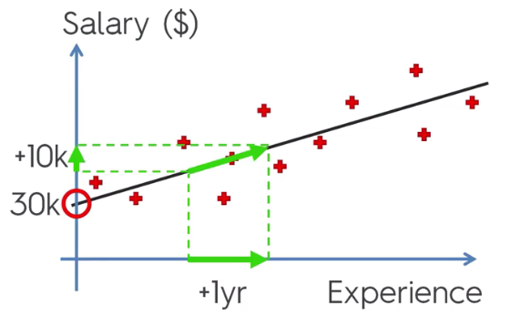
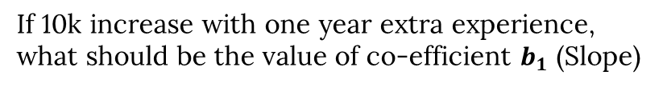
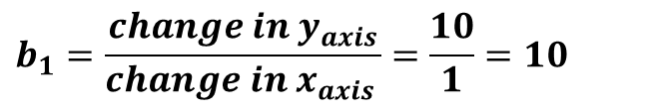
Simple Linear Regression
If 10k increase with one year extra experience, what should be the value of co-efficient $b_{1}$ (Slope)
$$b_{1}=\frac{change in y_{axis}}{chang{e in x}_{axis }}=\frac{10}{1}=10$$
If the Slope is less, the salary increase will be less.
If the Slope is greater, the salary increase will be greater.

Slide 12
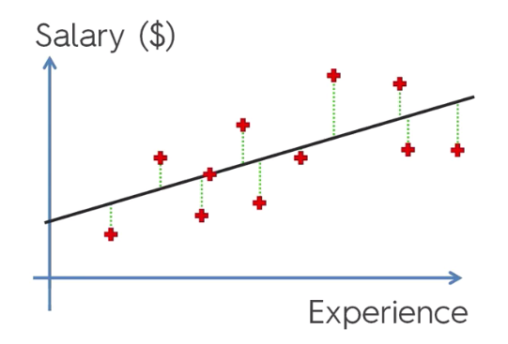
Simple Linear Regression
How to find the best fitted line?
Red dots are the actual observation
Lets, draw some vertical line from these dots to our regression model.
Take an example,
at a 10 years experience what is the actual observation and what is the predicted?
From this difference(error) we can see the model’s performance.
Actually, get the minimum errors is our goal in a regression model!

Slide 13
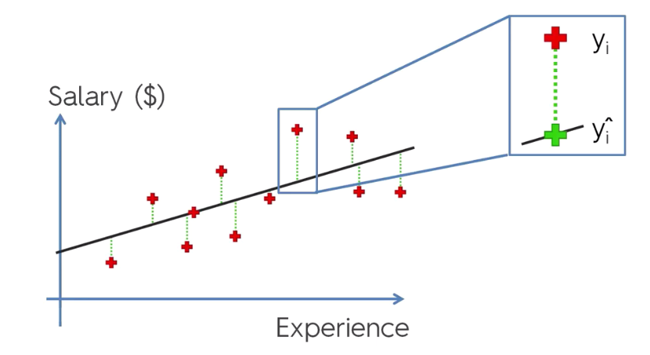
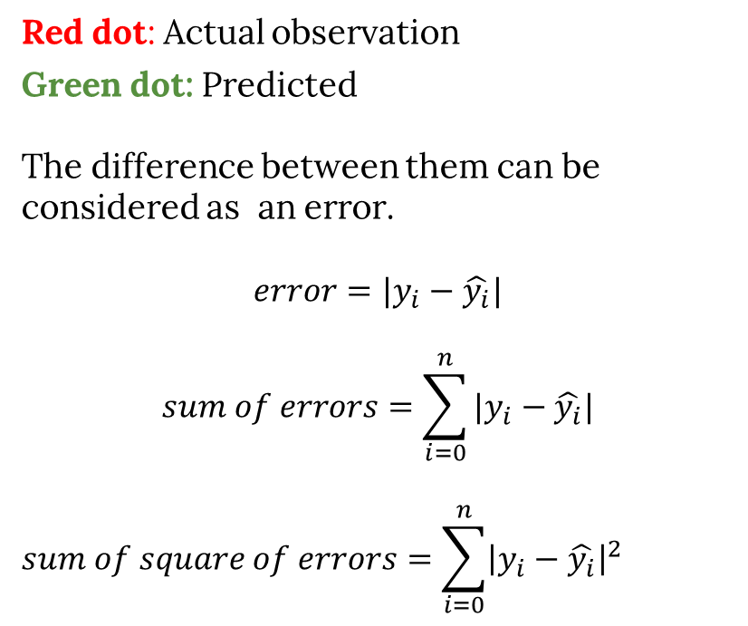
Simple Linear Regression
Red dot: Actual observation
Green dot: Predicted
The difference between them can be considered as an error.
$$error=|y_{i}−\hat{y_{i}}|$$
$$sum of errors=\sum_{i=0}^{n}{|y_{i}−\hat{y_{i}}|}$$
$$sum of square of errors=\sum_{i=0}^{n}{{\left|y_{i}−\hat{y_{i}}\right|}^{2}}$$
A best fit is that, where sum of square of errors is the lowest.

Slide 14
Simple Linear Regression
Example: Consider the following data where x is the independent variable and y is the dependent variable.
x | y
1.00 | 1.50
2.00 | 2.00
3.00 | 2.50
4.00 | 3.50
5.00 | 5.50
6.00 | 5.00
7.00 | 8.00
Find the values of Coefficient and the y-intercept.
Draw a regression line.

Slide 15

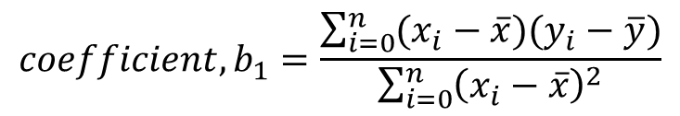
Simple Linear Regression
Finding Coefficient and y-intercept
$$coefficient, b_{1}=\frac{\sum_{i=0}^{n}{(x_{i}−\overline{x})(y_{i}−\overline{y})}}{\sum_{i=0}^{n}{{\left(x_{i}−\overline{x}\right)}^{2}}}$$
$y_{intercept} , b_{0}=\overline{y}−b_{1}\overline{x}$

Slide 16
Multiple Linear Regression
Md. Abu Naser Mojumder

Slide 17
Multiple Linear Regression
Multiple linear regression is used to estimate the relationship between two or more independent variables and one dependent variable.
You can use multiple linear regression when you want to know:
How strong the relationship is between two or more independent variables and one dependent variable (e.g. how rainfall, temperature, and amount of fertilizer added affect crop growth)
The value of the dependent variable at a certain value of the independent variables (e.g. the expected yield of a crop at certain levels of rainfall, temperature, and fertilizer addition).
Two Main Objectives of Multiple Linear Regression:
Establish if there is a relationship between two or more variables.
Forecast new observations.

Slide 18
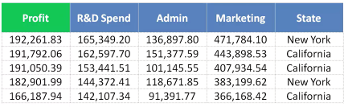
Multiple Linear Regression
The equation of Multiple Linear Regression:
bias term
$$y=b_{0}+b_{1}∗x_{1}+b_{2}∗x_{2}+..+b_{n}∗x_{n}$$
dependent variable
independent variable
y depends on multivariable.

Slide 19
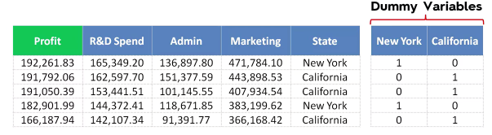
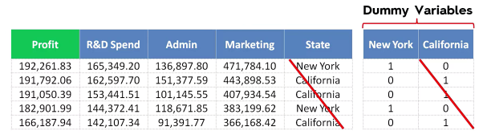
Multiple Linear Regression
Dummy Variable:
$$y=b_{0}+b_{1}∗x_{1}+b_{2}∗x_{2}+b_{3}∗x_{3}+b_{4}∗D_{1}$$

Slide 20
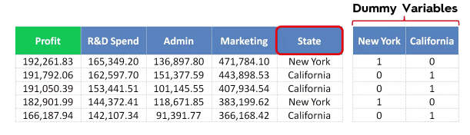

Multiple Linear Regression
Dummy Variable Trap:
Always omit one dummy variable. If we have 100 dummy variable we should keep 99 of them. Otherwise it will have a negative effect on the model.
Q. What is Dummy Variable trap? What will happen if we add all dummy variables?
Solution: https://youtu.be/5Q69P5r2u2A

Slide 21
Polynomial Regression
Md. Abu Naser Mojumder

Slide 22
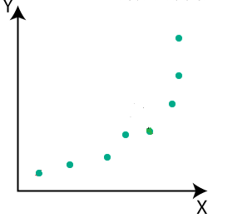
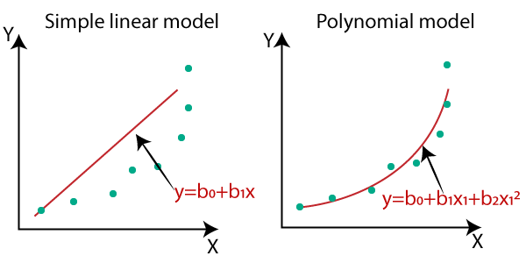
Polynomial Regression
The equation of Polynomial Regression:
$$y=b_{0}+b_{1}∗x_{1}+b_{2}∗x_{1}^{2}+..+b_{n}∗x_{1}^{n}$$

Slide 23
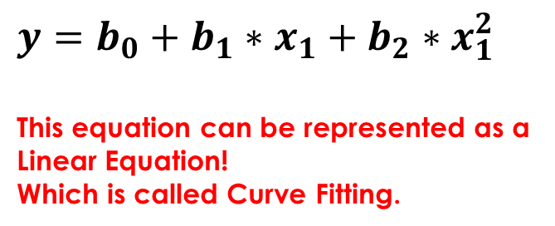
Polynomial Regression
Perfectly Fitted Line:
$$y=b_{0}+b_{1}∗x_{1}+b_{2}∗x_{1}^{2}$$
This equation can be represented as a Linear Equation!
Which is called Curve Fitting.
Q. The Polynomial Regression is also a Linear Regression! But why?

Slide 24
Logistic Regression
Md. Abu Naser Mojumder

Slide 25
Logistic Regression
Logistic Regression is a Supervised machine learning algorithm that can be used to model the probability of a certain class or event.
It is used when the data is linearly separable and the outcome is binary in nature.

Slide 26
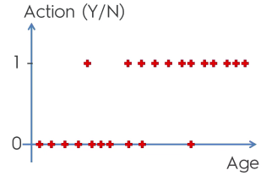
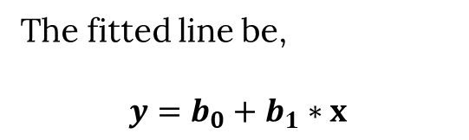
Logistic Regression
We already know how to deal with this type of challenge.
The fitted line be,
$$y=b_{0}+b_{1}∗x$$
But this is new:

Slide 27
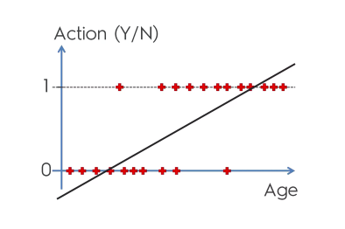
Logistic Regression
Lets consider, we need to classify persons according to their age.
The question is, “Are they suitable for a specific offer?”
This is a binary classification problem, we can’t fit like this:

Slide 28
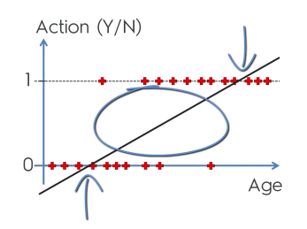
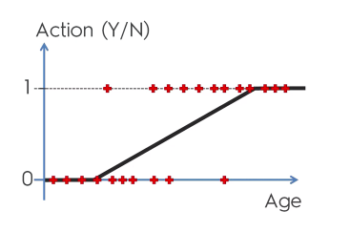
Logistic Regression
In a binary classification problem, the probability of a class has calculated. For our example the probability values are in between
0 and 1.
A certain age family is accepted this offer.
Let age > 5 to age < 55 is in between 0 and 1 probability. (fig. 1),
Now we need a function that fit these red point as much as possible and
Linear function does not work here surely.
We need such function that should fit like this(fig. 2):
Fig. 1
Fig. 2

Slide 29
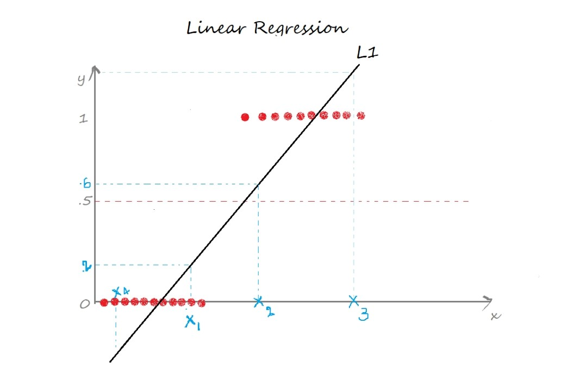

Slide 30
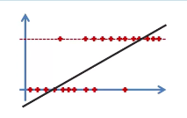
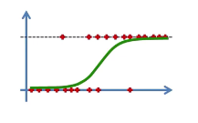
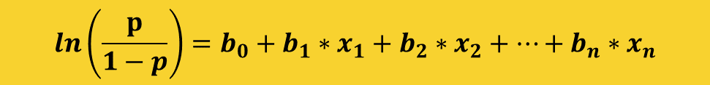
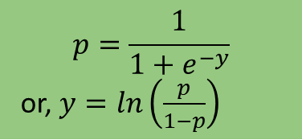
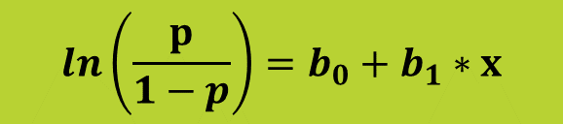

Logistic Regression
$$y=b_{0}+b_{1}∗x$$
$$p=\frac{1}{1+e^{−y}}$$
or, $y=ln⁡\left(\frac{p}{1−p}\right)$
Sigmoid Function
$$ln\left(\frac{p}{1−p}\right)=b_{0}+b_{1}∗x$$
The equation of Logistic Regression:
$$ln\left(\frac{p}{1−p}\right)=b_{0}+b_{1}∗x_{1}+b_{2}∗x_{2}+…+b_{n}∗x_{n}$$

Slide 31
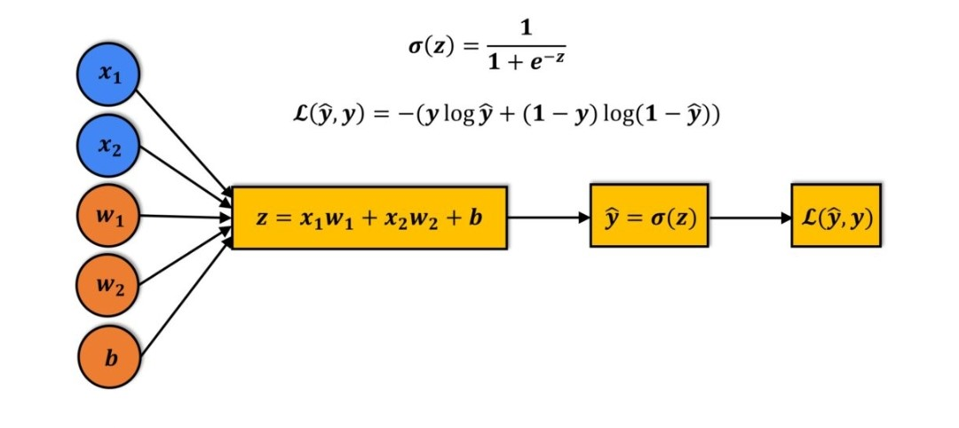

Slide 32
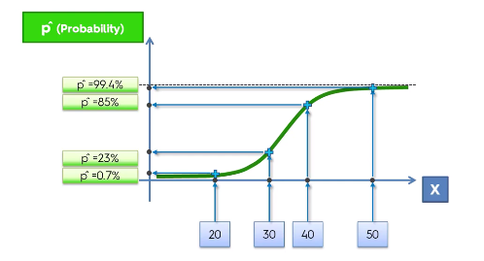
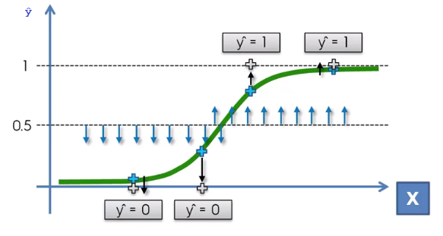
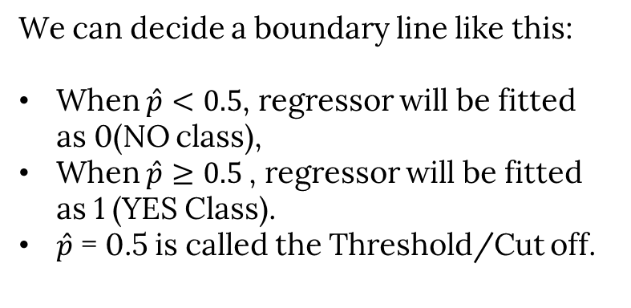
Logistic Regression
Here we have some observations:
Age | Probability
20 | 0.7%
30 | 23%
40 | 85%
50 | 99.4%
We can decide a boundary line like this:
When $\hat{p}<0.5$, regressor will be fitted as 0(NO class),
When $\hat{p}≥0.5$, regressor will be fitted as 1 (YES Class).
$\hat{p}$ = 0.5 is called the Threshold/Cut off.

Slide 33
Logistic Regression
Type of Logistic Regression:
On the basis of the categories, Logistic Regression can be classified into three types:
Binomial: In binomial Logistic regression, there can be only two possible types of the dependent variables, such as 0 or 1, Pass or Fail, etc.
Multinomial: In multinomial Logistic regression, there can be 3 or more possible unordered types of the dependent variable, such as "cat", "dogs", or "sheep”.
Ordinal: In ordinal Logistic regression, there can be 3 or more possible ordered types of dependent variables, such as “Low", "Medium", or "High".

Slide 34
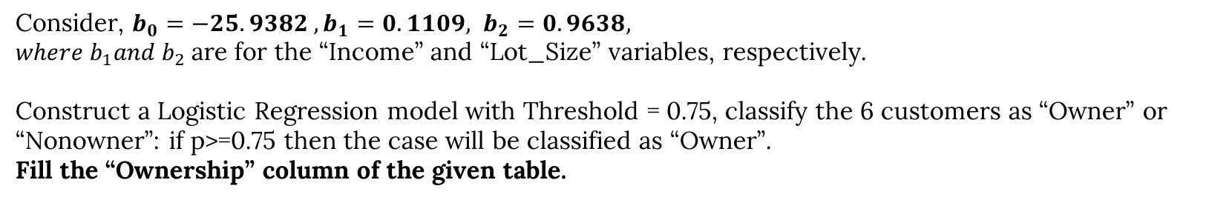
Logistic Regression
Review Questions
What is Feature Scaling?
Define Normalization and Standardization.
See the following Table and Answer the question:
Customer# | Income | Lot_Size | Ownership
1 | 60.0 | 18.4 | ?
2 | 64.8 | 21.6 | ?
3 | 84.0 | 17.6 | ?
4 | 59.4 | 16.0 | ?
5 | 108.0 | 17.6 | ?
6 | 75 | 19.6 | ?
Consider, $b_{0}=−25.9382 , b_{1}=0.1109, b_{2}=0.9638,$
$where b_{1}and b_{2}$are for the “Income” and “Lot_Size” variables, respectively.
Construct a Logistic Regression model with Threshold = 0.75, classify the 6 customers as “Owner” or “Nonowner”: if p>=0.75 then the case will be classified as “Owner”.
Fill the “Ownership” column of the given table.

Slide 35
k Nearest Neighbors
(k-NN)
Md. Abu Naser Mojumder

Slide 36
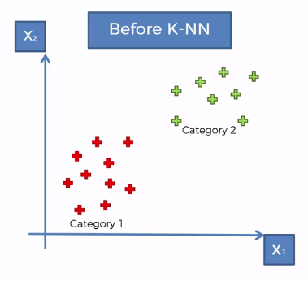
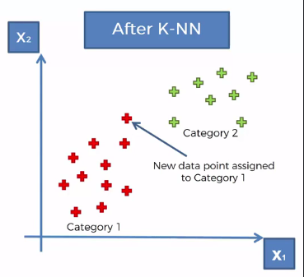
k- Nearest Neighbors
K-Nearest Neighbors is one of the most basic yet essential classification algorithms in Machine Learning. The classification has done with voting.
Consider we have a scenario where we have two categories of data.
Category 1 (Red) (X1)
Category 2 (Green) (X2)
We have two variables(Classes) X1 and X2, and
A new datapoint will be classified according to these two classes.
Now we add a new datapoint in dataset.
The question is, should it fall into the red category or green category? How do we decide that? How do we classify that new datapoint as a red or green datapoint?
And this point the k-NN algorithm will come to assist us.
By calculating the distances (similarities) among k-Neighbors, we can select the category.
At the end of performing this algorithm we'll be able to identify whether it's a red or green point,
And in this case the point turned out to be red.

Slide 37
k- Nearest Neighbors Algorithm
How its work?
Step 1: Choose the number K of neighbors
Step 2: Take the K nearest neighbors of the new datapoint, according to the Euclidean distance.
Step 3: Among these K neighbors, count the number of data points in each category.
Step 4: Assign the new data point to the category where you counted the most neighbors.
Your Model is Ready!

Slide 38
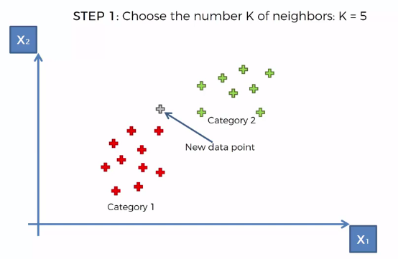
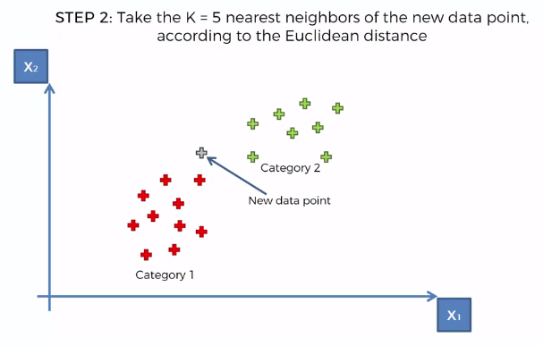
k- Nearest Neighbors
An example:

Slide 39
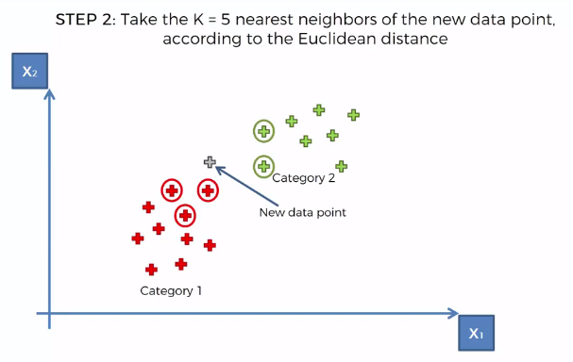
k- Nearest Neighbors

Slide 40
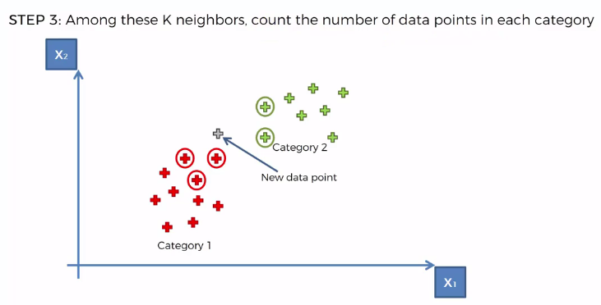
k- Nearest Neighbors
Category 1: 3 Neighbors
Category 2: 2 Neighbors
Therefore, The new point belongs to the Red Category.

Slide 41
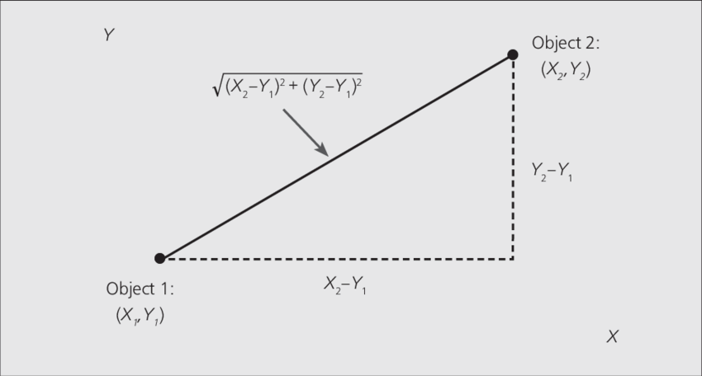
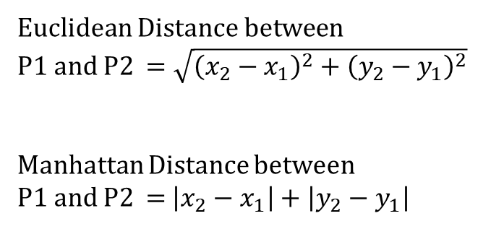
k- Nearest Neighbors
Euclidean Distance vs Manhattan Distance
Euclidean Distance between
P1 and P2 $=\sqrt{{\left(x_{2}−x_{1}\right)}^{2}+{\left(y_{2}−y_{1}\right)}^{2}}$
Manhattan Distance between
P1 and P2 = $\left|x_{2}−x_{1}\right|+\left|y_{2}−y_{1}\right|$

Slide 42
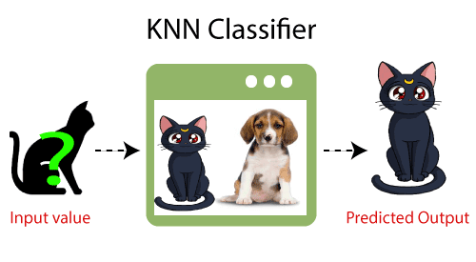
k- Nearest Neighbors
How to select the value of K in the K-NN Algorithm?
Below are some points to remember while selecting the value of K in the K-NN algorithm:
There is no particular way to determine the best value for "K", so we need to try some values to find the best out of them. The most preferred value for K is 5.
A very low value for K such as K=1 or K=2, can be noisy and lead to the effects of outliers in the model.
Large values for K are good, but it may find some difficulties.
The value of K must be a Odd Number.
Advantages of KNN Algorithm:
It is simple to implement.
It is robust to the noisy training data
It can be more effective if the training data is large.
Disadvantages of KNN Algorithm:
Always needs to determine the value of K which may be complex some time.
The computation cost is high because of calculating the distance between the data points for all the training samples.

Slide 43
k- Nearest Neighbors
Problem
Find out the type of P1(5.5, 6.3) with k-NN considering K=3
Class | X1 | X2
Class 1 | 1.0 | 1.2
 | 1.5 | 2.0
 | 3.0 | 4.1
Class 2 | 5.0 | 7.0
 | 3.5 | 5.3
 | 4.5 | 5.0
 | 3.5 | 4.5

Slide 44
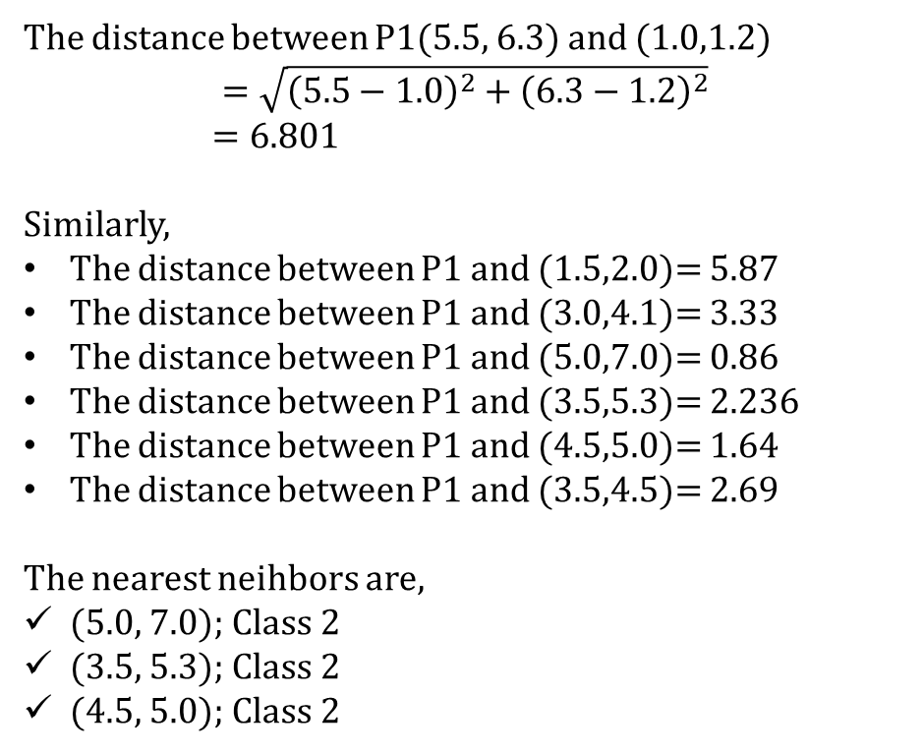
k- Nearest Neighbors
Solution:
Class | X1 | X2
Class 1 | 1.0 | 1.2
 | 1.5 | 2.0
 | 3.0 | 4.1
Class 2 | 5.0 | 7.0
 | 3.5 | 5.3
 | 4.5 | 5.0
 | 3.5 | 4.5
The distance between P1(5.5, 6.3) and (1.0,1.2)
$$=\sqrt{{\left(5.5−1.0\right)}^{2}+{\left(6.3−1.2\right)}^{2}}$$
$=6.801$
Similarly,
The distance between P1 and (1.5,2.0)= 5.87
The distance between P1 and (3.0,4.1)= 3.33
The distance between P1 and (5.0,7.0)= 0.86
The distance between P1 and (3.5,5.3)= 2.236
The distance between P1 and (4.5,5.0)= 1.64
The distance between P1 and (3.5,4.5)= 2.69
The nearest neihbors are,
(5.0, 7.0); Class 2
(3.5, 5.3); Class 2
(4.5, 5.0); Class 2
The most of k-neigbors belongs to Class 2, therefore, P1(5.5, 6.3) can be classified as Class 2

